Slide 1

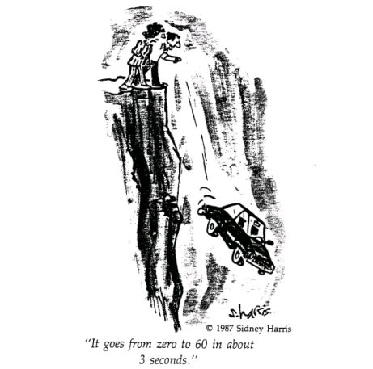

1. THE MECHANICS OF THE BODY
1.3 PHYSICS OF BODY CRASHING

Slide 2
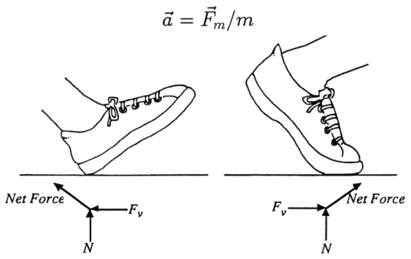
If a body of mass m is in constant motion no acceleration or deceleration occurs !
Acceleration a can be caused by leg muscle force F !
Deceleration can be caused by friction, muscle force or external forces (by running into a wall for example).

Slide 3

Friction occurs between a moving surface and a surface at rest:
N is the normal force!
μ_{k} is coefficient for kinetic friction:
for rubber-concrete: μ_{k} ≈ 0.8 joints between bones: μ_{k} ≈ 0.003
As smaller the coefficient as less resistance by frictional forces!
Friction force: F_{f} ≈ 640 N
deceleration: a ≈ 7.8 m/s²
For a walker of N ≈ W ≈ 800 N (m=82kg):
Accelerating muscle forces maintain a constant walking speed!

Slide 4



When the body bumps into a solid object (like a wall) rapid deceleration a occurs:
The decelerating force F_{d} applied by the wall to the body (or to whatever body part which hits first) causes pressure P_{d} which causes deformation:
A is the surface area of the body or body part exposed to the force.
Force is only applied over the time period Δt until complete stop.
Therefore:

Slide 5
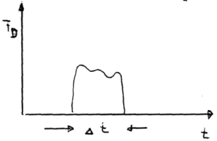
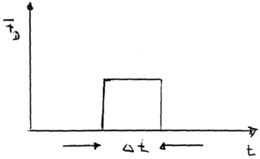
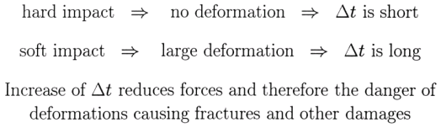
To calculate the impact force the time structure of the deceleration process needs to be known.
Approximation: treatment of force as a square pulse actual time structure may depend on particular impact

Slide 6
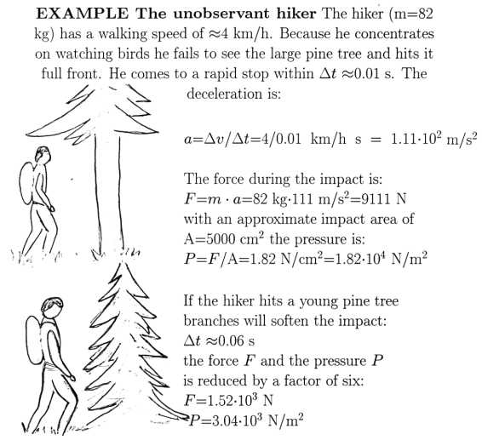

Slide 7
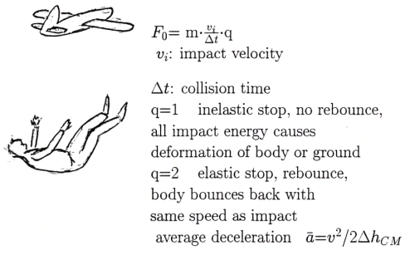
Falls from great height
The above equation has to be generalized because of energy transfer arguments!
The average force acting on the part of the body which hits the ground is

Slide 8
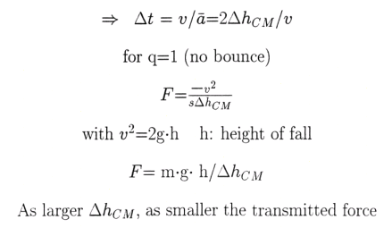
Body decelerates with average deceleration a from impact velocity v to zero while the center of mass of body moves over a distance a/Δ_{CM} during the collision

Slide 9
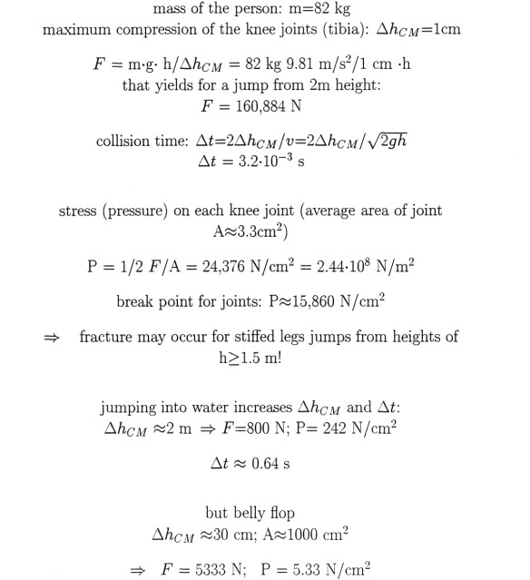
EXAMPLE: Stiffed leg jump on hard ground

Slide 10
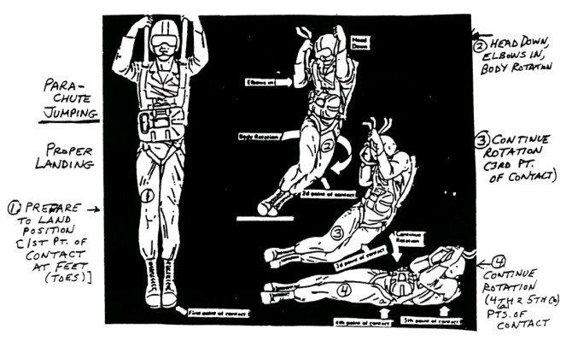
Tolerance levels for whole body impact
Threshold for survival: ≈ 20 mi/h = 36 km/h = 8.9 m/s
Effects of impact can be reduced by increasing Δt (Δh_{CM}) or by distributing force F over large area to reduce compressing stress.
proper landing techniques for parachutes
To survive a fall the impact pressure should be: ≤ 40 lbs/in² = 27.6 N/cm²
For an impact pressure of 35 N/cm² ≈ 50 % survival chance!

Slide 11
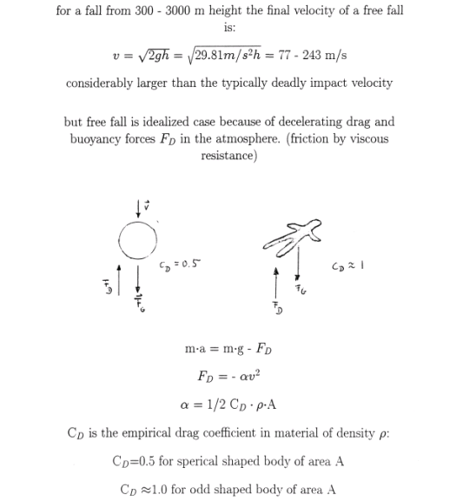
EXAMPLE: Free fall from large heights

Slide 12
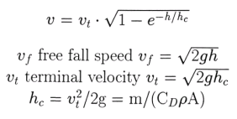
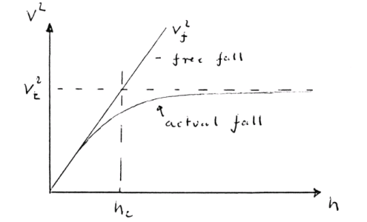
Solution of force equation yields final velocity v!
V²
V_{f}²
free fall
V_{t}²
actual fall
h_{c}
h

Slide 13
Exponential approach of speed of fall towards the terminal velocity!
Terminal velocity represents the state where the forces are in equilibrium!
h/h_{c} | e^{-h/hc} | V/V_{t}
1 | 0.37 | 0.79
2 | 0.14 | 0.975
3 | 0.050 | 0.975
4 | 0.018 | 0.991

Slide 14
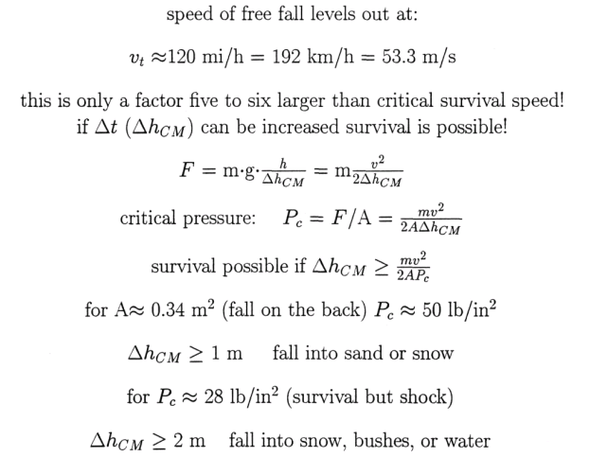

Slide 15
